Slide 1
Prediction of remaining oil based on deep learning 汇报人：吕云雪 2020.5.28

Slide 2
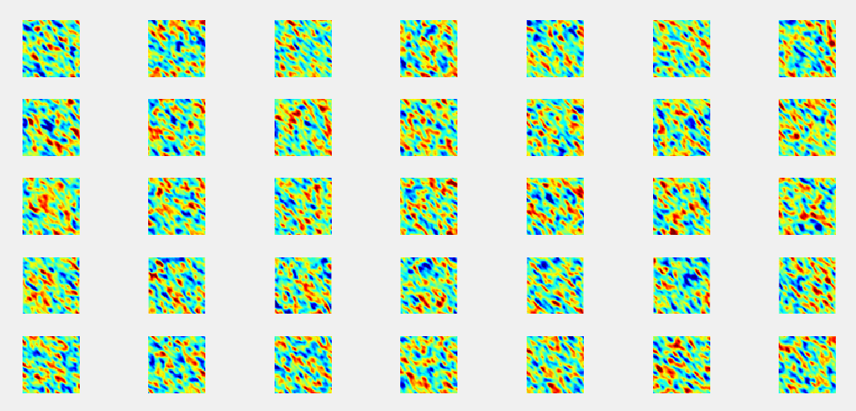
Study of reservoir simulation software
使用matlab初始建模，得到permx.data和PERMX.DATA文件

Slide 3
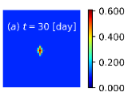
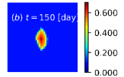
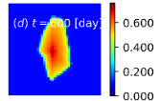

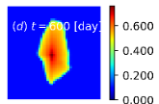
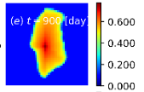
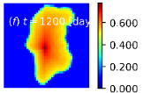
saturation
PERMX
6 steps，Simulation in eclipse

Slide 4
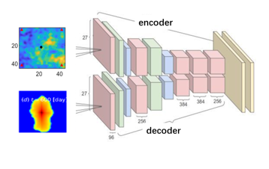
Test experiment
Problem：
Size of training sample and test sample is different.
Whether the input and output sample sizes are the same?
Different size samples as training set.

Slide 5
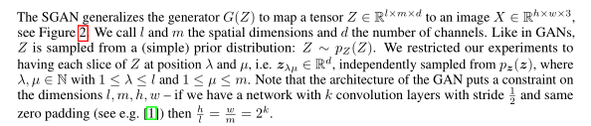
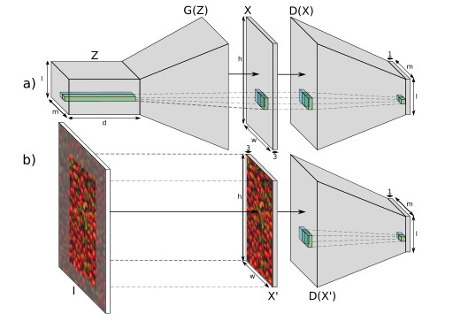
Paper: Texture Synthesis with Spatial Generative Adversarial Networks
this paper presented at the NIPS 2017.8

Slide 6
感谢倾听

